Slide 1
Evidence-enhanced Detection of Disinformation in Crypto News
CS 597: Online Social Network Analysis
Spring 2022
Final project by:
Priyam Dinesh Shah (pshah129@hawk.iit.edu),
William Edward Bodell III (wbodell@hawk.iit.edu)

Slide 2
Problem statement:
Crypto has a fake news problem. Given the rate at which new information disseminates through “Crypto Twitter”, how can an average user filter out the fake news?

Slide 3
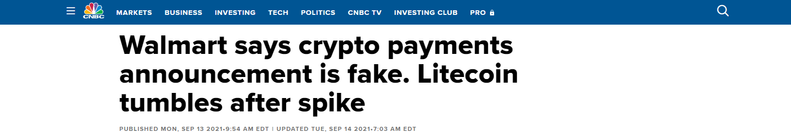
Motivation

Slide 4
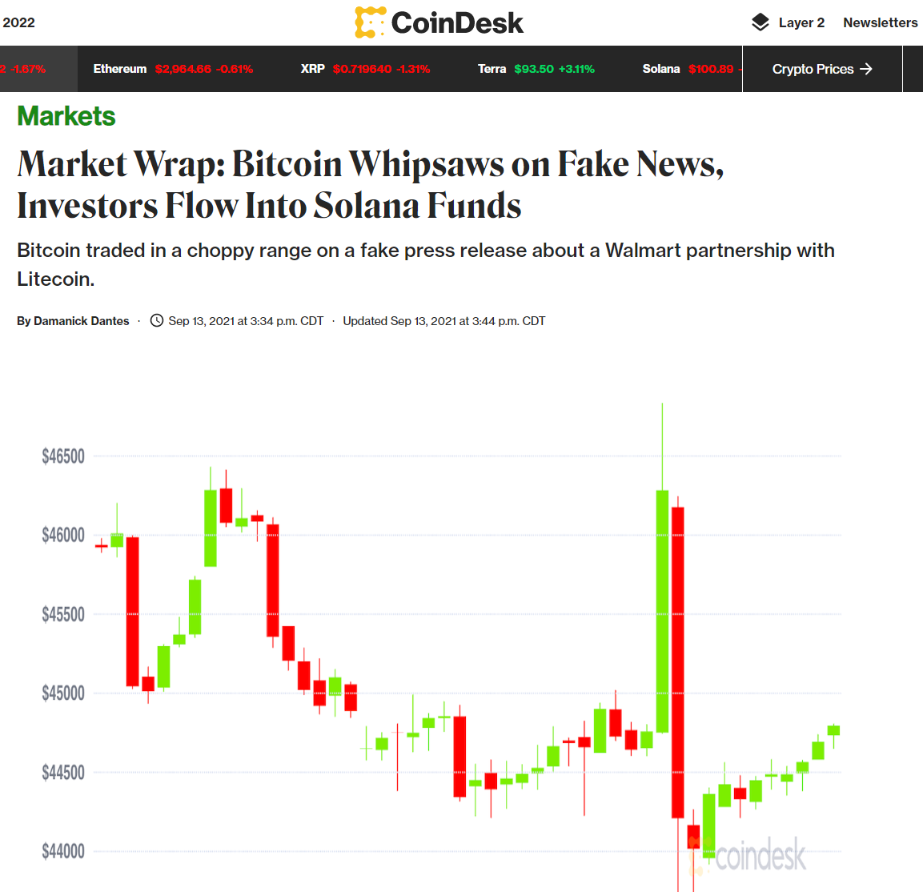
Motivation

Slide 5
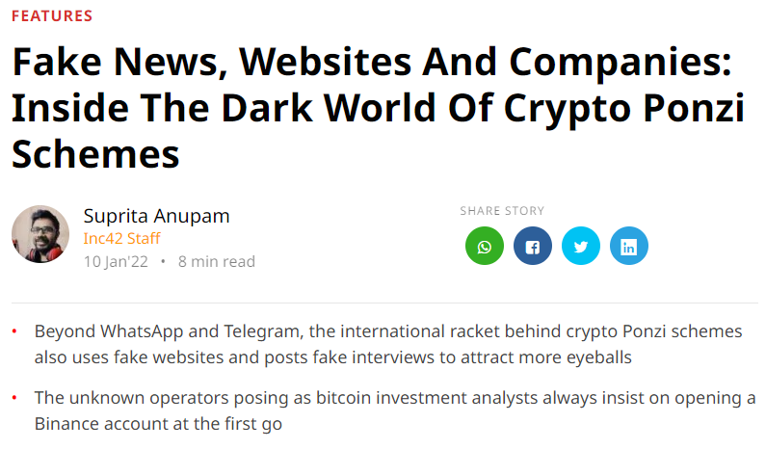
Motivation

Slide 6
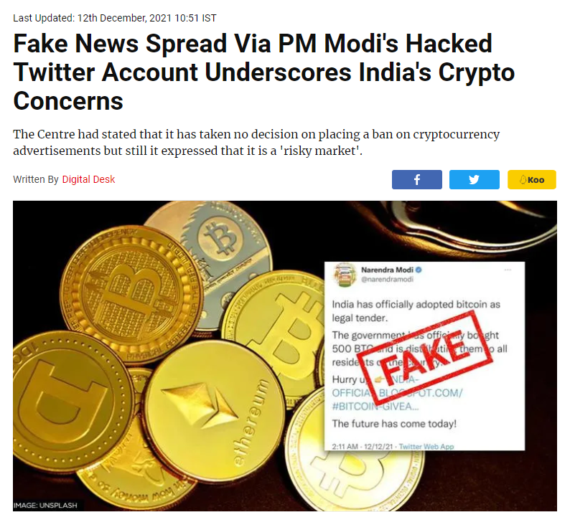
Motivation

Slide 7
Motivation

Slide 8
Motivation
The crypto market space is 1.78T and forecasted to grow even higher.

Slide 9
Motivation
The crypto market space is 1.78T and forecasted to grow even higher.
The space is highly dynamic and market prices are very responsive to a constant flood of newsbites (often misleading or fake) spread mainly on social networks like Twitter.

Slide 10
Motivation
The crypto market space is 1.78T and forecasted to grow even higher.
The space is highly dynamic and market prices are very responsive to a constant flood of newsbites (often misleading or fake) spread mainly on social networks like Twitter.
Especially as crypto has begun to achieve mainstream adoption, scammers have relied heavily on tactics such as embedding malicious links in fake news articles to lure in unsuspecting and inexperienced users as victims.

Slide 11
Motivation
The crypto market space is 1.78T and forecasted to grow even higher.
The space is highly dynamic and market prices are very responsive to a constant flood of newsbites (often misleading or fake) spread mainly on social networks like Twitter.
Especially as crypto has begun to achieve mainstream adoption, scammers have relied heavily on tactics such as embedding malicious links in fake news articles to lure in unsuspecting and inexperienced users as victims.
Our research aims to help users assess the validity of crypto news articles based on evidence sourced from online knowledge bases, with cosine similarity scores between 0.0 and 1.0 on a grayscale.

Slide 12
Motivation
The crypto market space is 1.78T and forecasted to grow even higher.
The space is highly dynamic and market prices are very responsive to a constant flood of newsbites (often misleading or fake) spread mainly on social networks like Twitter.
As crypto has seen mainstream adoption, scammers have relied heavily on tactics like embedding malicious links in fake news articles to lure in unsuspecting and inexperienced users as victims.
Our research aims to help users assess the validity of crypto news articles based on evidence sourced from online knowledge bases, with cosine similarity scores between 0.0 and 1.0 on a grayscale.

Slide 13
Methodology

Slide 14
Methodology
Our proposed methodology as we began our research was as follows:
Take input from the user some crypto news (i.e. a Tweet or a full article) he/she wants to verify.

Slide 15
Methodology
Our proposed methodology as we began our research was as follows:
Take input from the user some crypto news (i.e. a Tweet or a full article) he/she wants to verify.
We apply basic filters to check the article has enough word count and is from the crypto space.

Slide 16
Methodology
Our proposed methodology as we began our research was as follows:
Take input from the user some crypto news (i.e. a Tweet or a full article) he/she wants to verify.
We apply basic filters to check the article has enough word count and is from the crypto space.
If the input passes these filters, we process the input to create a bag of words.

Slide 17
Methodology
Our proposed methodology as we began our research was as follows:
Take input from the user some crypto news (i.e. a Tweet or a full article) he/she wants to verify.
We apply basic filters to check the article has enough word count and is from the crypto space.
If the input passes these filters, we process the input to create a bag of words.
We then separately query our KBs (i.e. Google, Twitter, EtherScan) with the prominent key words, retrieving the top results to analyze and compare with the input article using TF-IDF.

Slide 18
Methodology
Our proposed methodology as we began our research was as follows:
Take input from the user some crypto news (i.e. a Tweet or a full article) he/she wants to verify.
We apply basic filters to check the article has enough word count and is from the crypto space.
If the input passes these filters, we process the input to create a bag of words.
We then separately query our KBs (i.e. Google, Twitter, EtherScan) with the prominent key words, retrieving the top results to analyze and compare with the input article using TF-IDF.
With these we calculate a cosine similarity score from 0.0 to 1.0 for each query result.

Slide 19
Methodology
Our proposed methodology as we began our research was as follows:
Take input from the user some crypto news (i.e. a Tweet or a full article) he/she wants to verify.
We apply basic filters to check the article has enough word count and is from the crypto space.
If the input passes these filters, we process the input to create a bag of words.
We then separately query our KBs (i.e. Google, Twitter, EtherScan) with the prominent key words, retrieving the top results to analyze and compare with the input article using TF-IDF.
With these we calculate a cosine similarity score from 0.0 to 1.0 for each query result.
Testing our approach on some fake news, we observed high similarity scores with articles that reported the input as being fake, so we added the following step:
We divide each similarity score by the number of words found in the evidence which indicate true reporting about fake news, unless the input text contains these words too

Slide 20
Methodology
Our proposed methodology as we began our research was as follows:
Take input from the user, i.e. some crypto news (i.e. a Tweet or a full article) to verify.
Apply basic filters to check if it has sufficient word count and is from the crypto space.
If the input passes these filters, process the input to create a bag of words.
Separately query our KBs (i.e. Google) with the prominent key words, retrieving the top results to analyze and compare with the input article using TF-IDF.
With these, calculate a cosine similarity score from 0.0 to 1.0 for each query result.
Testing our approach on some fake news, we observed high similarity scores with articles that reported the input as being fake, so we added the following step:
Divide each score by the number of “fake news” words found in the evidence, i.e. which indicate true reporting about fake news, unless the input contains these words too. These “fake news” words include: “fake news”, “hoax”, “scam”, “illegitimate”, “false”, etc.

Slide 21
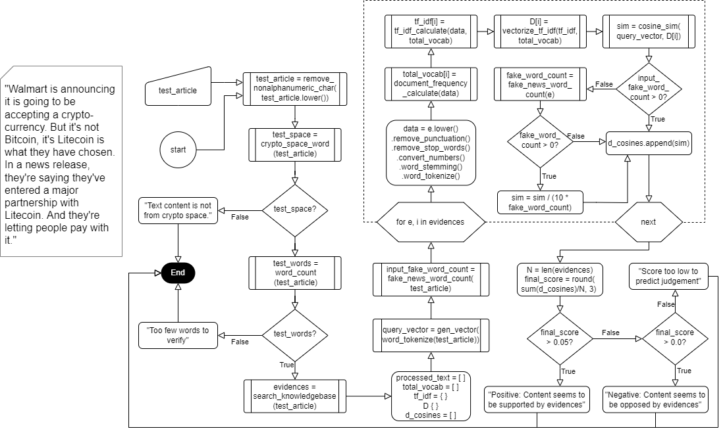
Methodology

Slide 22
Test Results

Slide 23
Results
Query Text : india has officially adopted bitcoin as legal tender the government has officially bought 500 btc and is distributing them to all residents of the country
~~~~~~~~~~~~~~~~~~~~~~~~~~~~~~~~~~~Final results~~~~~~~~~~~~~~~~~~~~~~~~~~~~~~~~~~~~~~~~~
Evidence 0 : Indian Prime Minister Narendra Modi's Twitter handle was compromised for a brief period on Saturday.The account was restored after sharing a link promising a Bitcoin BTC/USD giveaway.When it was hacked, misleading information was shared ...
Url: https://www.benzinga.com/markets/cryptocurrency/21/12/24562022/indian-prime-minister-modis-twitter-handle-hacked-falsely-...
Cosine Value: 0.05930240666005259
Evidence 1 : A tweet claiming that India has 'officially adopted bitcoin as legal tender' and bought 500 BTC and is distributing them among its residents was put out from itPrime Minister Narendra Modi's Twitter handle was briefly hacked on Sunday, and a ...
Url: https://www.firstpost.com/india/pm-narendra-modis-personal-twitter-handle-very-briefly-compromised-later-secured-pmo-...
Cosine Value: 0.04119176549959819
Evidence 2 : The tweet, after Prime Minister Narendra Modi's personal handle was hacked, also claimed that India has officially bought 500 BTC and is distributing them among its residents.Prime Minister Narendra Modi's Twitter handle was briefly hacked ...
Url: https://www.thehindu.com/news/national/pm-modis-twitter-handle-very-briefly-compromised-later-secured-pmo/article37937402.ece
Cosine Value: 0.03994367663954965
...
Average cosine similarity value for query and evidences is 0.023
Negative 😞!, Content seems to be opposed by evidences

Slide 24
Results
Query Text : Walmart is announcing it is going to be accepting a cryptocurrency. But it's not Bitcoin, it's Litecoin is what they have chosen. In a news release, they're saying they've entered a major partnership with Litecoin.
~~~~~~~~~~~~~~~~~~~~~~~~~~~~~~~~~~~Final results~~~~~~~~~~~~~~~~~~~~~~~~~~~~~~~~~~~~~~~~~
Evidence 0 : Walmart was the subject of a fake news release issued on Monday, Sept. 13, that falsely stated Walmart announced a partnership with Litecoin (LTC).Walmart had no knowledge of the press release issued by GlobeNewswire, and it is incorrect. ...
Url: https://corporate.walmart.com/newsroom/2021/09/13/walmart-statement-in-response-to-fake-litecoin-press-release
Cosine Value: 0.13488480530510094
Evidence 1 : Cryptocurrency litecoin gave up a 20% gain and tumbled back to Earth following a fake press release sent out by GlobeNewswire that referenced a partnership with Walmart.Walmart spokesman Randy Hargrove confirmed that the press release is not authentic.He also said the retailer has been in touch with the newswire company to investigate how the false press release got ...
Url: https://www.cnbc.com/2021/09/13/walmart-to-accept-payments-with-cryptocurrencies-using-litecoin.html
Cosine Value: 0.05652246624051879
Evidence 2 : A fake press statement released Monday claimed Walmart was partnering with the cryptocurrency Litecoin, leading to a brief but major stock gain for the company.The press release and the supposed merger was quickly revealed to be untrue, and its inauthenticity was confirmed by a Walmart spokesperson to CNBC.In the press release, the claim was made that Walmart—the biggest...
Url: https://www.newsweek.com/fake-announcement-that-walmart-will-accept-litecoin-cryptocurrency-sends-stock-soaring-1628492
Cosine Value: 0.044645119573423736
...
Average cosine similarity value for query and evidences is 0.042
Negative 😞!, Content seems to be opposed by evidences

Slide 25
Results
Query Text : MetaMask has formed a new strategic partnership with four major crypto custodians: Gnosis Safe, Hex Trust, GK8 and Parfin.
~~~~~~~~~~~~~~~~~~~~~~~~~~~~~~~~~~~Final results~~~~~~~~~~~~~~~~~~~~~~~~~~~~~~~~~~~~~~~~~
Evidence 0 : MetaMask has formed a new strategic partnership with four major crypto custodians: Gnosis Safe, Hex Trust, GK8 and Parfin.Decentralized finance (DeFi) wallet and browser extension MetaMask formed a new strategic partnership with four major...
Url: https://www.bitcoininsider.org/article/159867/metamask-expands-institutional-offering-integrating-new-crypto-custodians
Cosine Value: 0.17062060717946706
Evidence 1 : MetaMask has formed new strategic partnerships with four major cryptocurrency custodians, namely Hex Trust, Paraffin, Gnosis Safe and GK8.This announcement follows active expansion efforts on the firm’s offerings undergone by MetaMask...
Url: https://coinquora.com/metamask-integrates-with-crypto-custodians-to-expand-offerings/
Cosine Value: 0.1547151679517015
Evidence 2 : MetaMask expands institutional offering by integrating new crypto custodians13 Aprile 2022 - 02:00PM CointelegraphMetaMask has formed a new strategic partnership with four major crypto custodians: Gnosis Safe, Hex Trust, GK8 and ...
Url: https://it.advfn.com/mercati/COIN/BTCUSD/crypto-news/87824170/metamask-expands-institutional-offering-by-integra
Cosine Value: 0.12966830357745013
...
Average cosine similarity value for query and evidences is 0.083
Positive 😆!, Content seems to be supported by evidences

Slide 26
Results
Query Text : COTI turns bullish after increased integration with the Cardano ecosystem and the upcoming launch of MultiDAG 2.0 and the Djed stablecoin reflect strengthening fundamentals.
~~~~~~~~~~~~~~~~~~~~~~~~~~~~~~~~~~~Final results~~~~~~~~~~~~~~~~~~~~~~~~~~~~~~~~~~~~~~~~~
Evidence 0 : Development never stops in the fast-paced and competitive crypto sector and COTI is one project that is flashing some bullish signs.VORTECS™ charts from Cointelegraph Markets Pro show that COTI, an enterprise-grade financial technology platform focused on decentralized payments and digitization for any form of currency, could be on the verge of a breakout.The indicator...
Url: https://cointelegraph.com/news/indicators-flash-bullish-on-coti-ahead-of-its-mainnet-and-djed-stablecoin-launch
Cosine Value: 0.3272001834850179
Evidence 1 : Quantstamp, DigitalBits and AirSwap climb higher as the wider market stagnates and traders take an early weekend in observance of Good Friday.Continue ReadingAltcoin WatchCryptocurrenciesMarketsmarkets pro COTI turns bullish after increased integration with the Cardano ecosystem and the upcoming launch of MultiDAG 2.0 and the Djed stablecoin reflect strengthening...
Url: https://bitcoinfeed.xyz/tag/markets-pro/
Cosine Value: 0.1714705835814072
Evidence 2 : Epoxy Composites Market was valued at USD 30.80 billion in 2021 and projected to grow at a CAGR of 6.32% during ... Pune India, April 22, 2022 (GLOBE NEWSWIRE) -- The market has been studied for the below mentioned-segmentation and regional...
Url: https://www.ehtrend.com.br/en/tt/7402224/revenue.html
Cosine Value: 0.08058385859573304
...
Average cosine similarity value for query and evidences is 0.108
Positive 😆!, Content seems to be supported by evidences

Slide 27
Future Scope

Slide 28
Future Scope
Adding more knowledge bases, such as Twitter and Etherscan, as we only got around to using Google search to find evidence.
Using transactional data based on user requested query as a weighted parameter.
Extending further to use expert-based suggestions as a weighted parameter for the results.
Applying machine learning models to filter evidences.

Slide 29
Thank you!

